Slide 1

Global Human Trafficking
Xavier Mojica’s DS6390 Project

Slide 2

S.O.S in Disguise
The unity of individuals is the background, black, with the white stark juxtaposition cutting out that person.
Each 74 pixels represent each number of individuals trafficked from the data set.
Is it a child, is it a young adult, male or female?
Notes:
cutting people away from their unity to be isolated in the foreground. The silhouette is ambiguous, androgenous , it it a child, is it a young adult, or male or female ? There is no gender to the abducted and lost, they are all humans suffering and exploited, no race.
https://editor.p5js.org/monchemin1/sketches/O54S7iQvk

Slide 3
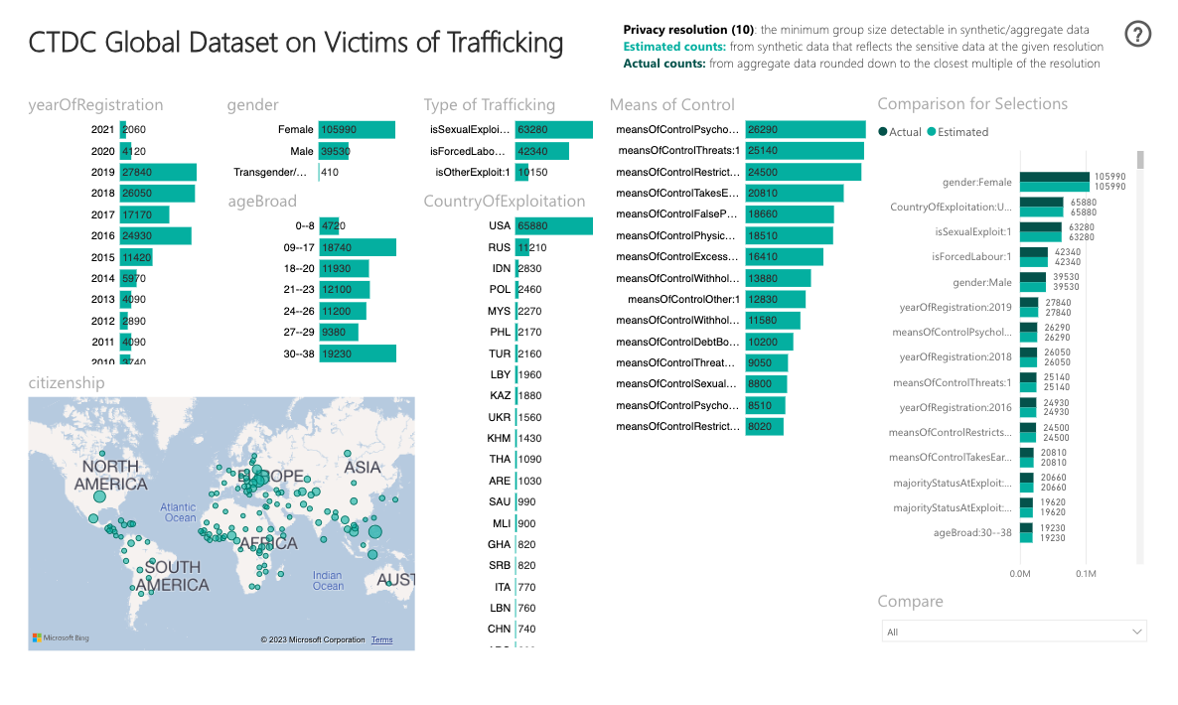
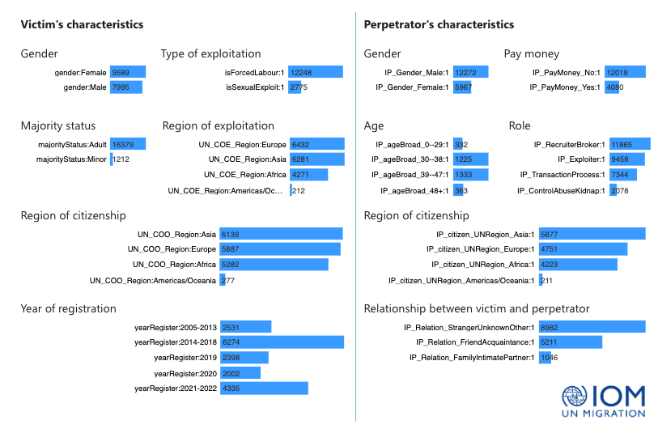
Global Data
Notes:
https://www.ctdatacollaborative.org/page/global-synthetic-dataset
That’s the site where i got the data sets and 2 images

Slide 4
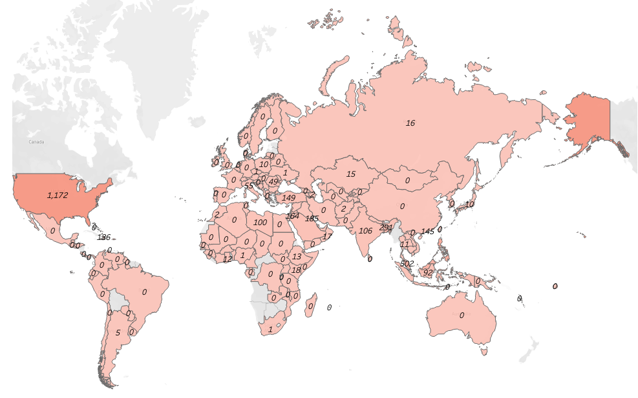
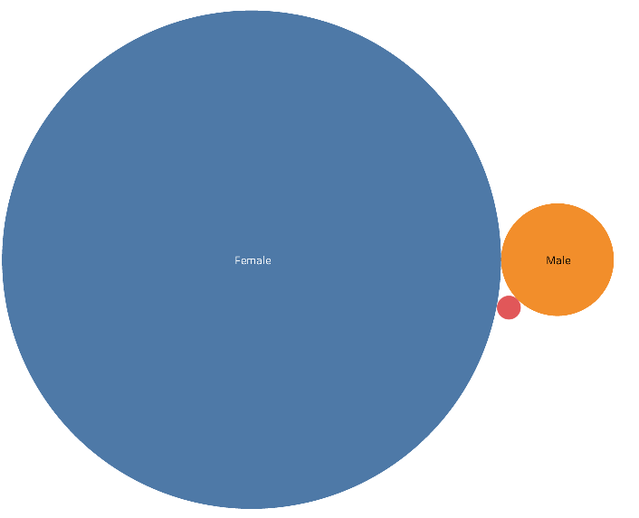
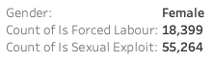
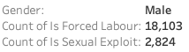
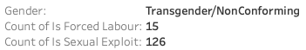
Global Data
Domestic Labour
Gender v. Sexual Exploitation & Forced Labour

Slide 5
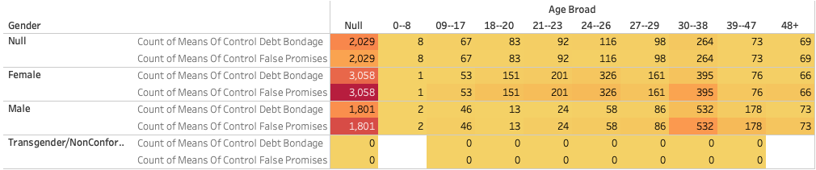
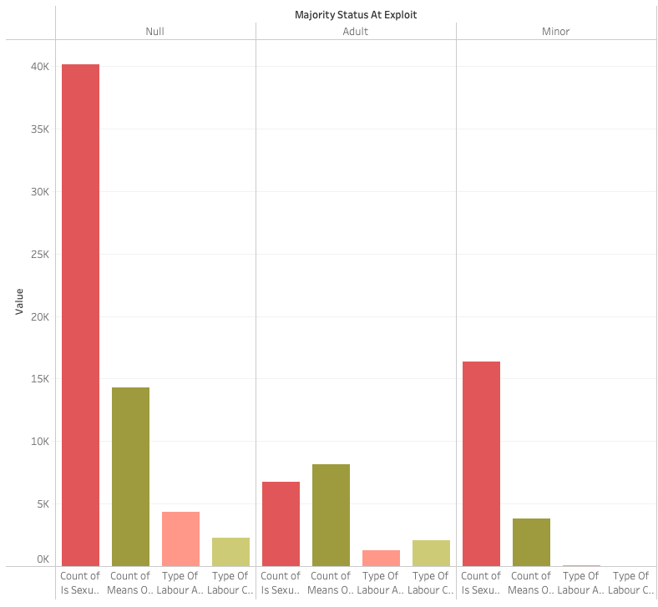
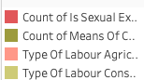
Global Data
Debt Bondage & Excessive Working Hours by Age
Majority Status at Exploit

Slide 6
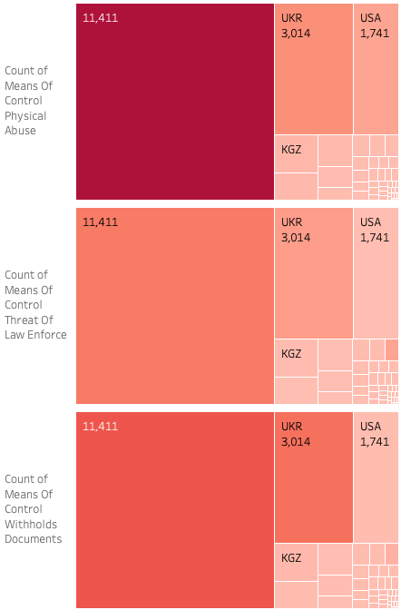
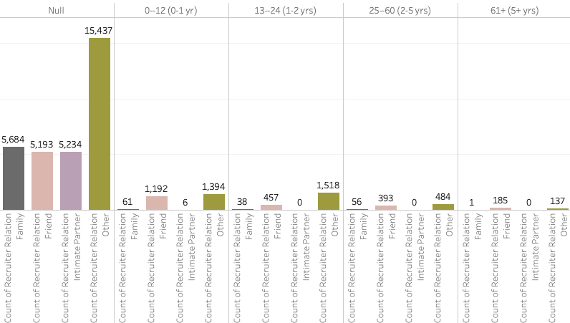
Global Data
Citizenship v. Types of Abuse
Traffic Months

Slide 7
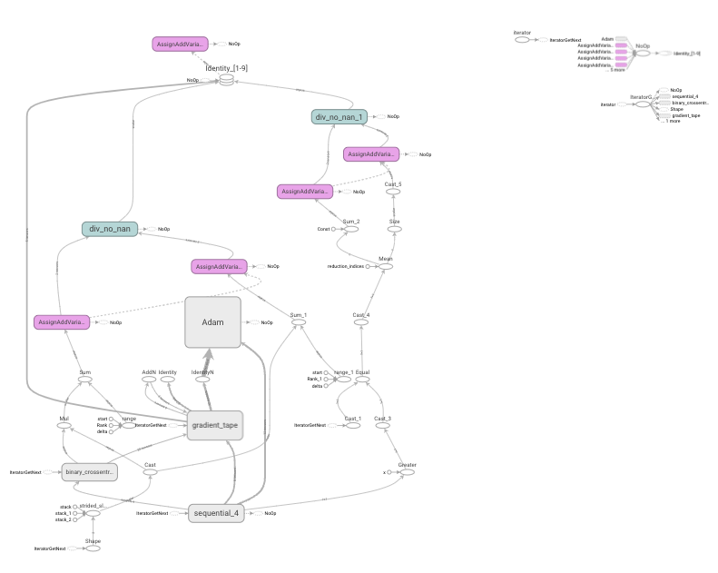
Neural Network
What’s a Neural Network?
A Neural Networks use interconnected nodes in a layered structure.
Each node connects to other nodes that have an associated weight and threshold.
It looks like the human brain.
Notes:
Site where I have the neural network.
https://colab.research.google.com/drive/16bkDm-yWTB4nPEE7WCHX5Peac11P9rdn?usp=sharing

